Slide 1
Threaded Binary Tree

Slide 2
Threaded Binary Tree
A threaded binary tree is a type of binary tree data structure where the empty left and right child pointers in a binary tree are replaced with threads that link nodes directly to their in-order predecessor or successor, thereby providing a way to traverse the tree without using recursion or a stack.
Threaded binary trees can be useful when space is a concern, as they can eliminate the need for a stack during traversal. However, they can be more complex to implement than standard binary trees.

Slide 3
Two types of threaded binary trees
Single Threaded: Where a NULL right pointers is made to point to the inorder successor (if successor exists)
Double Threaded: Where both left and right NULL pointers are made to point to inorder predecessor and inorder successor respectively. The predecessor threads are useful for reverse inorder traversal and postorder traversal.
The threads are also useful for fast accessing ancestors of a node.

Slide 4
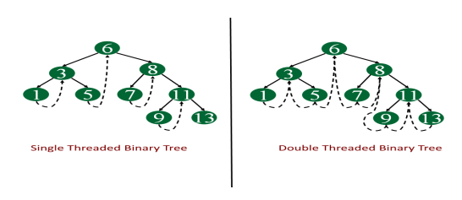
Threaded Binary Tree

Slide 5
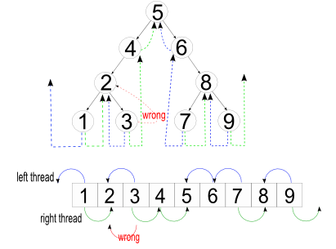
Threaded Binary Tree

Slide 6
Advantages of Threaded Binary Tree
It enables linear traversal of elements.
It eliminates the use of stack as it perform linear traversal, so save memory.
Enables to find parent node without explicit use of parent pointer
Threaded tree give forward and backward traversal of nodes by in-order fashion
Nodes contain pointers to in-order predecessor and successor
For a given node, we can easily find inorder predecessor and successor. So, searching is much more easier.
In threaded binary tree there is no NULL pointer present. Hence memory wastage in occupying NULL links is avoided.
The threads are pointing to successor and predecessor nodes. This makes us to obtain predecessor and successor node of any node quickly.
There is no need of stack while traversing the tree, because using thread links we can reach to previously visited nodes.

Slide 7
Disadvantages of Threaded Binary Tree
Every node in threaded binary tree need extra memory to indicate whether its left or right node indicated its child nodes or its inorder predecessor or successor. So, the node consumes extra memory.
Insertion and deletion are more complex and time consuming as both threads and ordinary links need to be maintained.
Implementing threads for every possible node is complicated.
Increased complexity: Implementing a threaded binary tree requires more complex algorithms and data structures than a regular binary tree. This can make the code harder to read and debug.
Extra memory usage: In some cases, the additional pointers used to thread the tree can use up more memory than a regular binary tree. This is especially true if the tree is not fully balanced, as threading a skewed tree can result in a large number of additional pointers.
Limited flexibility: Threaded binary trees are specialized data structures that are optimized for specific types of traversal. While they can be more efficient than regular binary trees for these types of operations, they may not be as useful in other scenarios. For example, they cannot be easily modified (e.g. inserting or deleting nodes) without breaking the threading.
Difficulty in parallelizing: It can be challenging to parallelize operations on a threaded binary tree, as the threading can introduce data dependencies that make it difficult to process nodes independently. This can limit the performance gains that can be achieved through parallelism.

Slide 8
Applications of threaded binary tree
Expression evaluation: Threaded binary trees can be used to evaluate arithmetic expressions in a way that avoids recursion or a stack. The tree can be constructed from the input expression, and then traversed in-order or pre-order to perform the evaluation.
Database indexing: In a database, threaded binary trees can be used to index data based on a specific field (e.g. last name). The tree can be constructed with the indexed values as keys, and then traversed in-order to retrieve the data in sorted order.
Symbol table management: In a compiler or interpreter, threaded binary trees can be used to store and manage symbol tables for variables and functions. The tree can be constructed with the symbols as keys, and then traversed in-order or pre-order to perform various operations on the symbol table.
Disk-based data structures: Threaded binary trees can be used in disk-based data structures (e.g. B-trees) to improve performance. By threading the tree, it can be traversed in a way that minimizes disk seeks and improves locality of reference.
Navigation of hierarchical data: In certain applications, threaded binary trees can be used to navigate hierarchical data structures, such as file systems or web site directories. The tree can be constructed from the hierarchical data, and then traversed in-order or pre-order to efficiently access the data in a specific order.

